Slide 1
https://www.youtube.com/watch?v=cCMBILKngPM

Slide 2
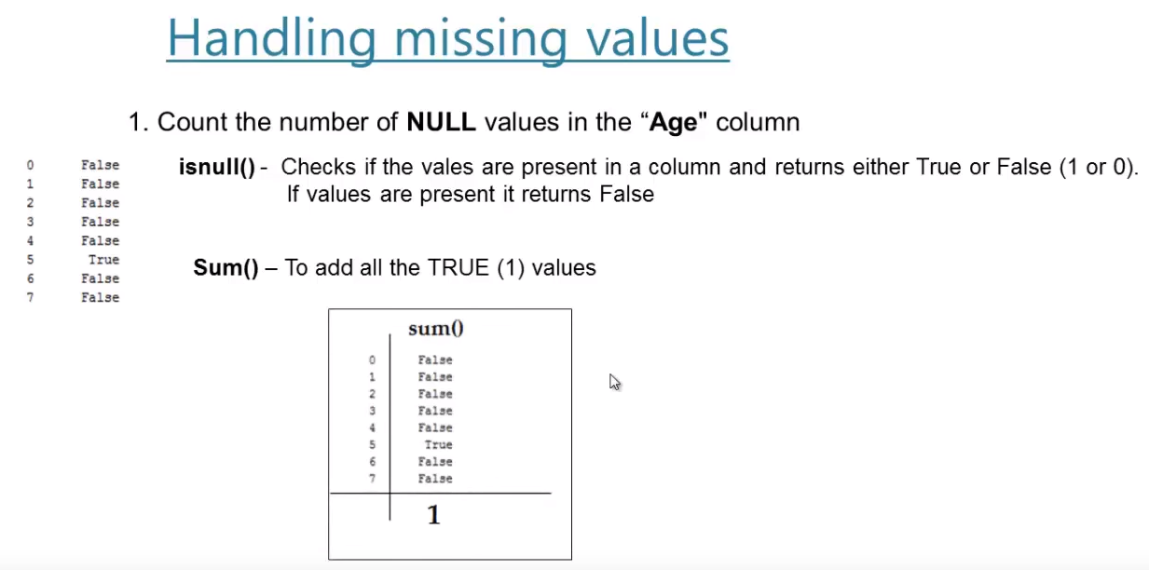
If value presents, prints as FALSE
Otherwise, prints as TRUE

Slide 3
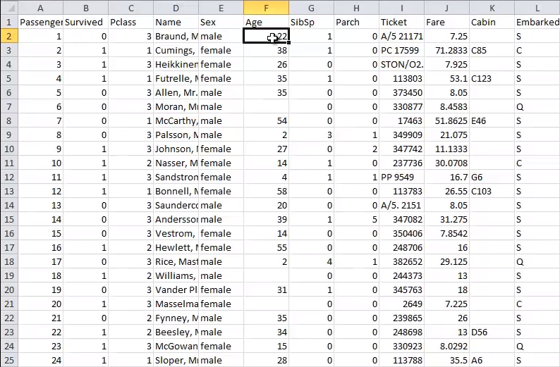

Slide 4
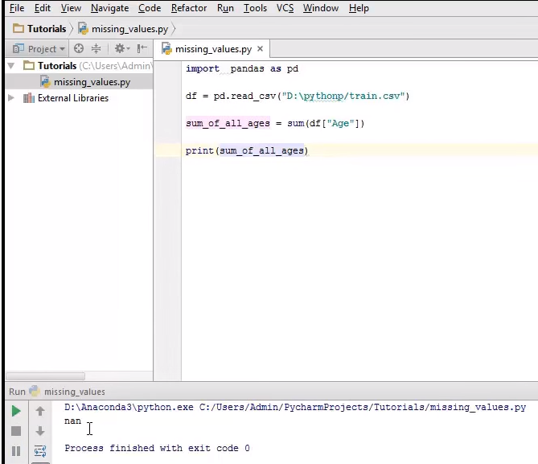

Slide 5
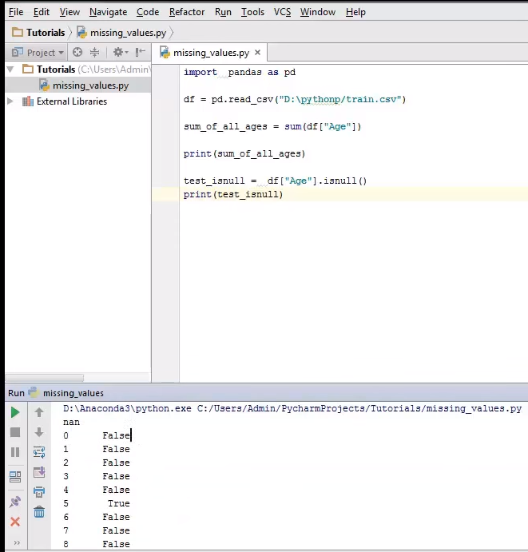

Slide 6
